Slide 1
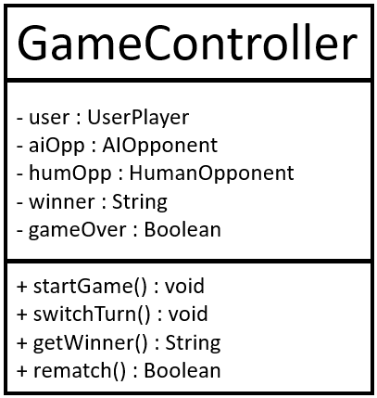
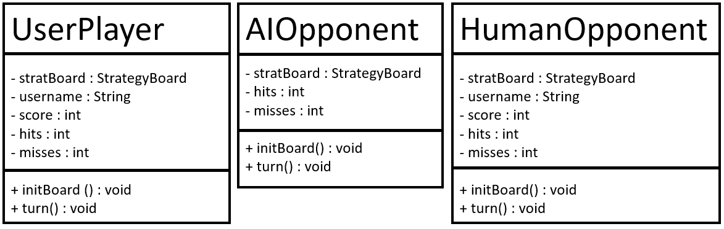
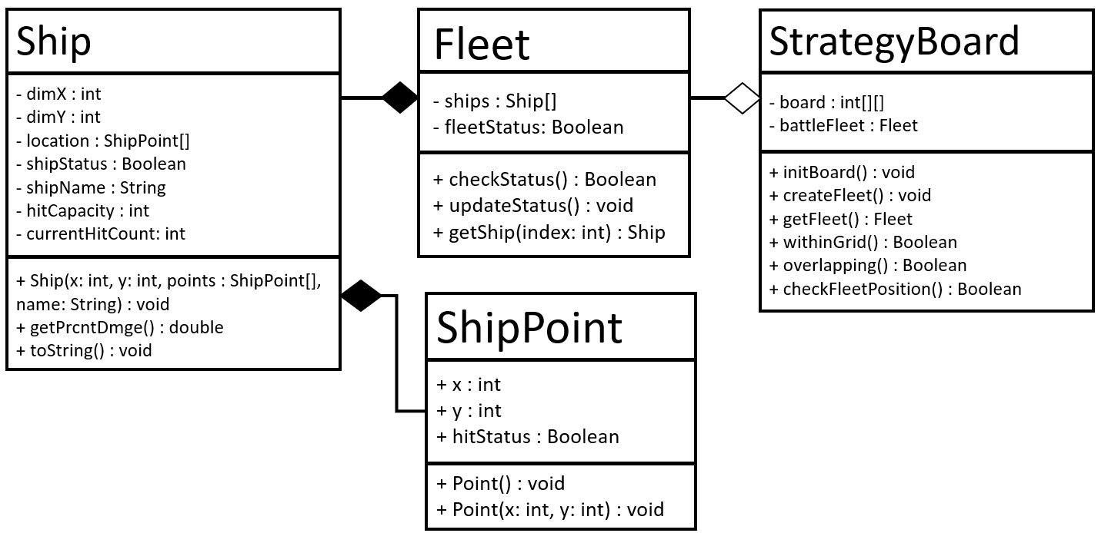
Deliverables #2 UML Diagram

Slide 2
Deliverables #2’s UML Diagram Snippet
Ship
- dimX : int
- dimY : int
- location : ShipPoint[]
- shipStatus : Boolean
- shipName : String
- hitCapacity : int
- currentHitCount: int
+ Ship(x: int, y: int, points : ShipPoint[], name: String) : void
+ getPrcntDmge() : double
+ toString() : void
Fleet
- ships : Ship[]
- fleetStatus: Boolean
+ checkStatus() : Boolean
+ updateStatus() : void
+ getShip(index: int) : Ship
StrategyBoard
- board : int[][]
- battleFleet : Fleet
+ initBoard() : void
+ createFleet() : void
+ getFleet() : Fleet
+ withinGrid() : Boolean
+ overlapping() : Boolean
+ checkFleetPosition() : Boolean
ShipPoint
+ x : int
+ y : int
+ hitStatus : Boolean
+ Point() : void
+ Point(x: int, y: int) : void

Slide 3
Deliverables #2’s UML Diagram Snippet
UserPlayer
- stratBoard : StrategyBoard
- username : String
- score : int
- hits : int
- misses : int
+ initBoard () : void
+ turn() : void
AIOpponent
- stratBoard : StrategyBoard
- hits : int
- misses : int
+ initBoard() : void
+ turn() : void
HumanOpponent
- stratBoard : StrategyBoard
- username : String
- score : int
- hits : int
- misses : int
+ initBoard() : void
+ turn() : void
GameController
- user : UserPlayer
- aiOpp : AIOpponent
- humOpp : HumanOpponent
- winner : String
- gameOver : Boolean
+ startGame() : void
+ switchTurn() : void
+ getWinner() : String
+ rematch() : Boolean

Slide 4
For Deliverables #2 (excluding getters/setters)
Java Class: ShipPoint
Instance Variables: (all public)
x (int) – x-coordinate of ship point
y (int) – y-coordinate of ship point
hitStatus (Boolean) – status of ship point (hit = true/1, not hit = false/0).
Class Methods: (all public)
+ Point() : void –instantiates Ship Point with coordinate (0,0) and hitStatus = 0.
+ Point(x: int, y: int) : void –instantiates Ship Point with coordinate (x,y) and hitStatus = 0.

Slide 5
For Deliverables #2
Java Class: Ship
Instance Variables: (all private)
dimX (int) – width of ship
dimY (int) – length of ship
location (ShipPoint[]) – the coordinates taken by the ship on the board
shipStatus (Boolean) – status of ship (active = true/1, sunk = false/0).
shipName (String) – ship’s name (e.g., “Aircraft Carrier”, “Cruiser”, “Destroyer”, “Submarine”, “Corvette”, etc.)
hitCapacity (int) – number of attackable points on the ship
currentHitCount (int) – number of points on ship hit by opponent
Class Methods: (all public)
+ Ship(x: int, y: int, points : ShipPoint[], name: String) : void –instantiates Ship object with specified dimensions, coordinate-points, and ship name.
+ getPrcntDmge() : double –returns the percent damage the ship has taken (currentHitCount/hitCapacity * 100)
+ toString() : void –returns Ship object’s information in the following format:
Name: …
Width: …
Length: …
Location: …
Status: …
Current Hits Taken: …
Hit Capacity: …

Slide 6
For Deliverables #2
Java Class: Fleet
Instance Variables: (all private)
ships (Ship[]) – array of Ship objects.
fleetStatus (Boolean) – status of fleet (all ships sunk = false/0, otherwise = true/1)
Class Methods: (all public)
+ checkStatus() : Boolean –returns fleet status = 0 for all ships sunk, 1 otherwise.
+ updateStatus() : void –updates the fleet’s status (checks all ship statuses)
+ getShip(index: int) : Ship –takes in an index and returns corresponding Ship object from fleet’s array of ships.

Slide 7
For Deliverables #2
Java Class: StrategyBoard
Instance Variables: (all private)
board (int[][]) – 10x10 2D int array representing water grid.
battleFleet (Fleet) – Player’s ships
Class Methods: (all public)
+ initBoard() : void –initialized board (places 0s through entire water grid).
+ createFleet() : void –creates and places player’s fleet on water grid
+ withinGrid() : Boolean –checks if all ships are inside the board (within the bounds of the water grid).
+ overlapping() : Boolean –checks whether there are ships overlapping (0 = no overlapping, 1 = overlapping)
+ checkFleetPosition() : Boolean –checks whether player has correctly placed entire fleet on water grid.

Slide 8
For Deliverables #2
Java Class: UserPlayer
Instance Variables: (all private)
stratBoard (StrategyBoard) – player’s StrategyBoard object.
username (String) – player’s name
score (int) – player’s score
hits (int) – player’s successful hits against opponent
misses (int) – player’s misses against opponent
Class Methods: (all public)
+ initBoard() : void –initialized player’s board and creates/sets fleet.
+ turn() : void –initiates the player’s turn

Slide 9
For Deliverables #2
Java Class: AIOpponent
Instance Variables: (all private)
stratBoard (StrategyBoard) – AI’s StrategyBoard object.
hits (int) – AI’s successful hits against player
misses (int) – AI’s misses against player
Class Methods: (all public)
+ initBoard() : void –initialized AI’s board and creates/sets fleet.
+ turn() : void –initiates the AI’s turn

Slide 10
For Deliverables #2
Java Class: HumanOpponent
Instance Variables: (all private)
stratBoard (StrategyBoard) – opponent’s StrategyBoard object.
username (String) – opponent’s name
score (int) – opponent’s score
hits (int) – opponent’s successful hits against opponent
misses (int) – opponent’s misses against opponent
Class Methods: (all public)
+ initBoard() : void –initialized opponent’s board and creates/sets fleet.
+ turn() : void –initiates the opponent’s turn

Slide 11
For Deliverables #2
Java Class: GameController
Instance Variables: (all private)
user (UserPlayer) – player1.
aiOpp (AIOpponent) – player1’s AI opponent
humOpp (HumanOpponent) – player1’s human opponent
winner (String) – winner’s (player1 or their opponent’s) name
gameOver (Boolean) – game over status (game ended = true/1, game continues = false/0)
Class Methods: (all public)
+ startGame () : void –starts match by initializing player1 and opponent’s boards and creating/setting fleets.
+ switchTurn() : void –initiates next player’s turn
+ getWinner() : String –returns winner’s name
+ rematch() : Boolean –returns whether player1 or their opponent wishes for a rematch (rematch requested = true/1, rematch not requested/declined = false/0)

Slide 12
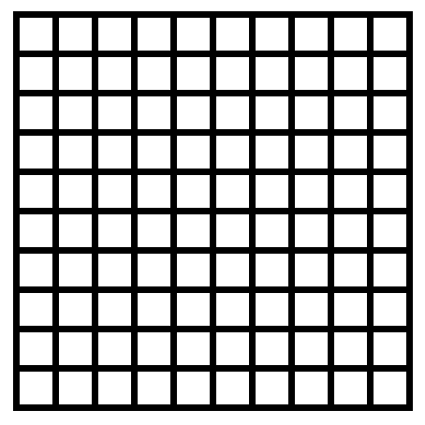
Strategy Board (initialization of P1’s board):
0
0
0
0
0
0
0
0
0
0
0 = No ships are placed
0
0
0
0
0
0
0
0
0
0
0
0
0
0
0
0
0
0
0
0
0
0
0
0
0
0
0
0
0
0
0
0
0
0
0
0
0
0
0
0
0
0
0
0
0
0
0
0
0
0
0
0
0
0
0
0
0
0
0
0
0
0
0
0
0
0
0
0
0
0
0
0
0
0
0
0
0
0
0
0
0
0
0
0
0
0
0
0
0
0

Slide 13
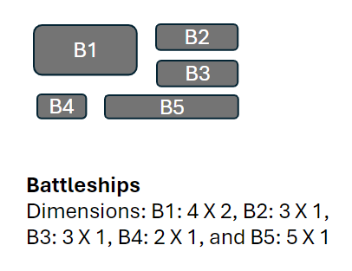
Strategy Board (example below of P1’s board after entire fleet is placed):
1
1
1
1
0
0
0
0
0
0
0 = where no ship is placed
1 = where B1 is placed
2 = where B2 is placed
3 = where B3 is placed
4 = where B4 is placed
5 = where B5 is placed
1
1
1
1
0
0
0
0
0
0
0
0
0
0
0
5
5
5
5
5
0
0
0
0
0
0
0
0
0
0
0
0
0
2
2
2
0
0
0
0
0
0
0
0
0
0
0
0
0
0
0
0
0
0
0
0
0
0
0
0
0
3
0
0
0
0
0
0
0
0
0
3
0
0
0
0
0
4
4
0
0
3
0
0
0
0
0
0
0
0
checkFleetPosition() would return true, as all ships are in valid positions (no overlapping or crossing grid boundaries).
Only if checkFleetPosition() is true, can Player 1 continue to the first round of attacks.

Slide 14
Strategy Board (example below of P1’s board after hits have been exchanged with enemy):
1
1
1
1
0
0
0
10
0
0
0 = where no ship is placed
1 = where B1 is placed
2 = where B2 is placed
3 = where B3 is placed
4 = where B4 is placed
5 = where B5 is placed
Add +10 to any place an enemy’s attack has been launched
(e.g., 10 = enemy missed, 11 = B1 has been hit, …, 15 = B5 has been hit.
1
1
1
1
0
0
0
0
0
0
0
0
0
10
0
5
5
5
5
5
0
0
0
0
0
0
0
0
0
0
0
10
0
12
12
2
0
0
10
0
0
0
0
0
0
0
0
0
0
0
10
0
0
0
0
0
0
10
0
0
0
3
0
10
0
0
0
0
0
0
0
3
0
0
0
0
0
4
4
0
0
3
0
0
0
0
0
0
0
0
Player 1’s strategy board is modified (as above) through the rounds. +10 to coordinates that have been targeted by enemy.

Slide 16
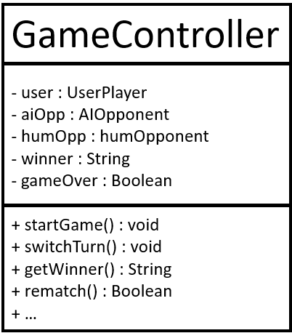
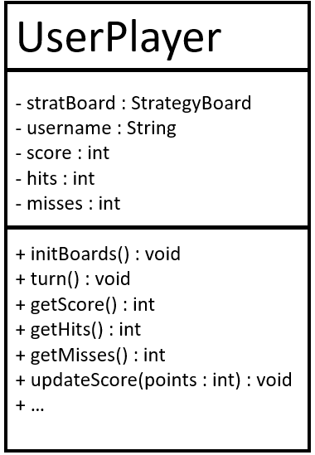
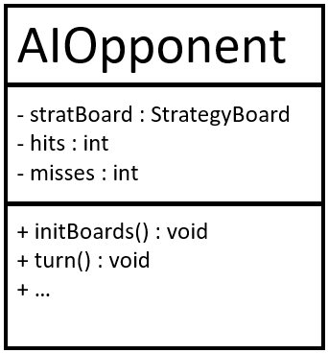
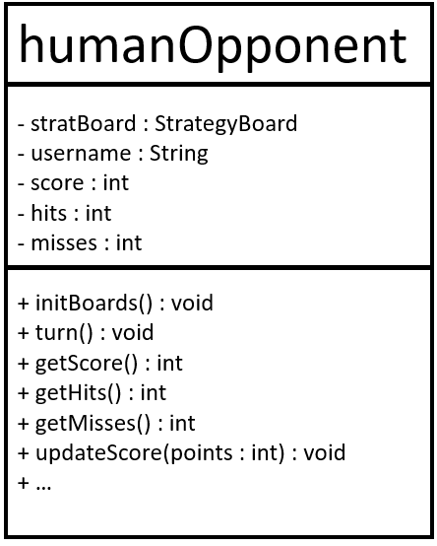
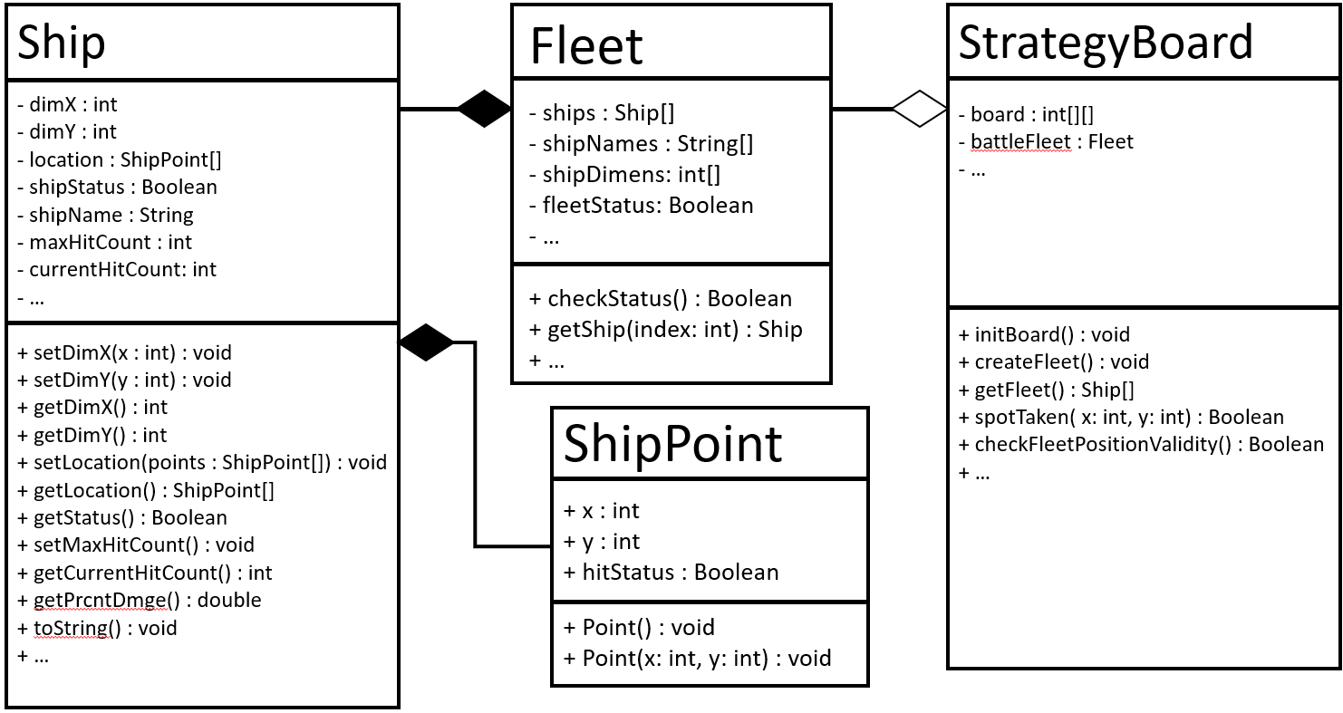
Rough draft

Slide 17
Rough draft
Ship
- dimX : int
- dimY : int
- location : ShipPoint[]
- shipStatus : Boolean
- shipName : String
- hitCapacity : int
- currentHitCount: int
- …
+ setDimX(x : int) : void
+ setDimY(y : int) : void
+ getDimX() : int
+ getDimY() : int
+ setLocation(points : ShipPoint[]) : void
+ getLocation() : ShipPoint[]
+ getStatus() : Boolean
+ setHitCapacity (hitCap : int) : void
+ getCurrentHitCount() : int
+ getPrcntDmge() : double
+ toString() : void
+ …
Fleet
- ships : Ship[]
- shipNames : String[]
- shipDimens: int[]
- fleetStatus: Boolean
- …
+ checkStatus() : Boolean
+ updateStatus() : void
+ getShip(index: int) : Ship
+ …
StrategyBoard
- board : int[][]
- battleFleet : Fleet
- …
+ initBoard() : void
+ createFleet() : void
+ getFleet() : Fleet
+ withinGrid( x: int, y: int) : Boolean
+ spotTaken( x: int, y: int) : Boolean
+ checkFleetPositionValidity() : Boolean
+ …
ShipPoint
+ x : int
+ y : int
+ hitStatus : Boolean
+ Point() : void
+ Point(x: int, y: int) : void

Slide 18
Rough draft
GameController
- user : UserPlayer
- aiOpp : AIOpponent
- humOpp : humOpponent
- winner : String
- gameOver : Boolean
+ startGame() : void
+ switchTurn() : void
+ getWinner() : String
+ rematch() : Boolean

Slide 19
Rough draft
UserPlayer
- stratBoard : StrategyBoard
- username : String
- score : int
- hits : int
- misses : int
+ initBoards() : void
+ turn() : void
+ getScore() : int
+ getHits() : int
+ getMisses() : int
+ updateScore(points : int) : void
AIOpponent
- stratBoard : StrategyBoard
- hits : int
- misses : int
+ initBoards() : void
+ turn() : void
humanOpponent
- stratBoard : StrategyBoard
- username : String
- score : int
- hits : int
- misses : int
+ initBoards() : void
+ turn() : void
+ getScore() : int
+ getHits() : int
+ getMisses() : int
+ updateScore(points : int) : void

Slide 20
Rough draft
Java Class: Ship
Instance Variables:
dimX (int) – width of ship
dimY (int) – length of ship
location (ShipPoint[]) – the coordinates taken by the ship on the board
shipStatus (Boolean) – status of ship (active = true/1, sunk = false/0).
shipName (String) – ship’s name (e.g., “Aircraft Carrier”, “Cruiser”, “Destroyer”, “Submarine”, “Corvette”, etc.)
hitCapacity (int) – number of attackable points on the ship
currentHitCount (int) – number of points on ship hit by opponent
Example: Ship B1 after being created
dimX = 4 (4 units wide)
dimY = 2 (2 units long)
location = Point[dimX*dimY] (points not set yet)
shipStatus = true (ship is active, not sunk)
shipName = “Aircraft Carrier”
maxHitCount = 8 (# of attackable points on ship)
currentHitCount = 0 (no points hit yet)
x
4
y
2
B1
Aircraft Carrier

Slide 21
Rough draft
Java Class: Ship
Class Methods:
setDimX(x : int) – sets ship’s width
setDimY(y : int) – sets ship’s length
getDimX() – returns ship’s width
getDimY() – returns ship’s length
setLocation(points : ShipPoint[]) – sets location of the Ship object on the board
getLocation() – returns array of ShipPoint objects
getStatus() – returns true is ship is active, false if ship is sunk.
setHitCapacity() – sets amount of damage required for the ship to sink (in # of attackable points on the ship)
getCurrentHitCount() – returns ship’s current damage (in # of points on the ship that are attacked) in int data type.
getPrcntDmge(ship: Ship) – takes a Ship object and returns the percent damage it’s taken (in double data type).

Slide 22
x
y

